Slide 1

Practice of Deep Learning Day 1, Part 4/4
Matthieu De Mari

Slide 2
About this lecture
How to implement a shallow Neural Network manually and define a forward propagation method for it?
Next million dollar question: How to train a shallow Neural Network using backpropagation?
How to define backward propagation and trainer functions?

Slide 3
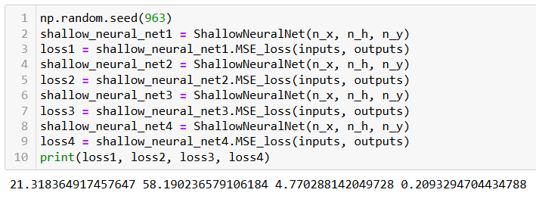
The need for a training procedure
At the moment, we have coded a model that can initialize trainable parameters randomly, formulate predictions and evaluate its own performance.
It is great, but we have no way to adjust the weights manually.
We can only try a few different initialization and pray the RNG gods to give us trainable parameters with a good loss.
We need a training procedure!
What could it be…?

Slide 4
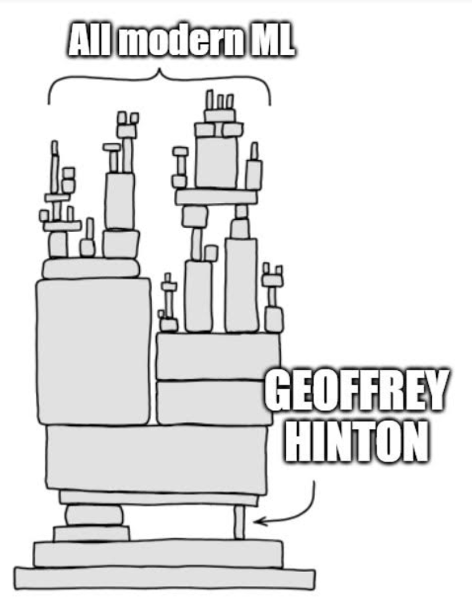
The backpropagation mechanism
Definition (Backpropagation):
Backpropagation is an algorithm used to train neural networks.
It is a type of gradient descent (what a surprise!) algorithm that allows the network to learn by adjusting the weights of the connections between the neurons in the network.
Introduced by Hinton and Rumelhart [Rumelhart1986].
(Or was it? [Medium2020])

Slide 5
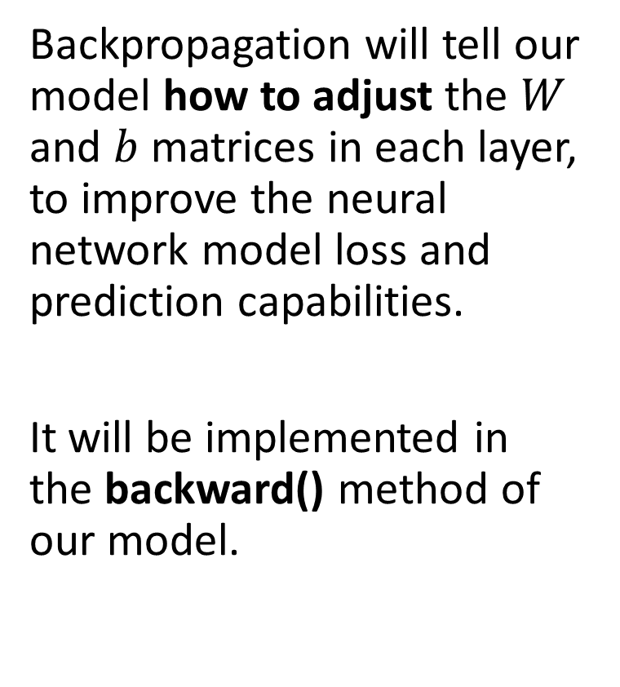
The backpropagation mechanism
Definition (Backpropagation):
Backpropagation is an algorithm used to train neural networks.
It is a type of gradient descent (what a surprise!) algorithm that allows the network to learn by adjusting the weights of the connections between the neurons in the network.
Introduced by Hinton and Rumelhart [Rumelhart1986].
(Or was it? [Medium2020])
Backpropagation will tell our model how to adjust the $W$ and $b$ matrices in each layer, to improve the neural network model loss and prediction capabilities.
It will be implemented in the backward() method of our model.

Slide 6
Backpropagation is heavy to manually calculate and implement… Strongly encouraging to try and redo the math/implementation shown hereafter on your own!
That’s the best way to learn and you can always refer to these slides for answers!
After math is correct, have a look at how to implement it in a backward method (also shown in slides, but probably will be shown rapidly in class!)

Slide 7
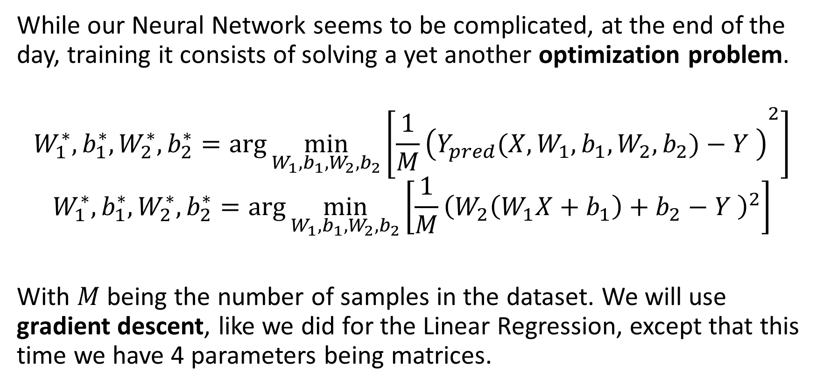
Backpropagation in our model
While our Neural Network seems to be complicated, at the end of the day, training it consists of solving a yet another optimization problem.
$$W_{1}^{∗},b_{1}^{∗},W_{2}^{∗}, b_{2}^{∗}=\arg{\min_{W_{1},b_{1},W_{2},b_{2}}\left[{\frac{1}{M}\left(Y_{pred}(X,W_{1},b_{1},W_{2},b_{2})−Y \right)}^{2}\right]}$$
$$W_{1}^{∗},b_{1}^{∗},W_{2}^{∗}, b_{2}^{∗}=\arg{\min_{W_{1},b_{1},W_{2},b_{2}}\left[{\frac{1}{M}\left(W_{2}\left(W_{1}X+b_{1}\right)+b_{2}−Y \right)}^{2}\right]}$$
With $M$ being the number of samples in the dataset. We will use gradient descent, like we did for the Linear Regression, except that this time we have 4 parameters being matrices.

Slide 8
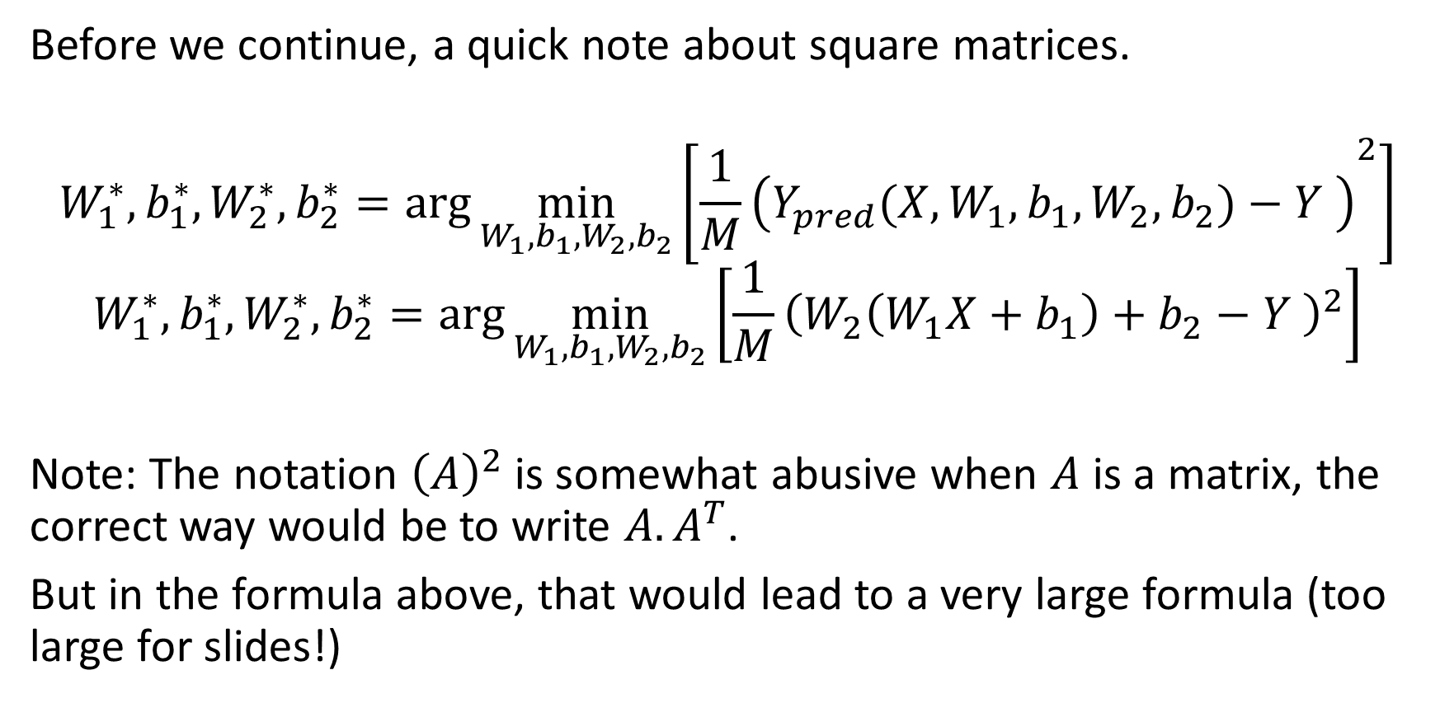
Before we continue
Before we continue, a quick note about square matrices.
$$W_{1}^{∗},b_{1}^{∗},W_{2}^{∗}, b_{2}^{∗}=\arg{\min_{W_{1},b_{1},W_{2},b_{2}}\left[{\frac{1}{M}\left(Y_{pred}(X,W_{1},b_{1},W_{2},b_{2})−Y \right)}^{2}\right]}$$
$$W_{1}^{∗},b_{1}^{∗},W_{2}^{∗}, b_{2}^{∗}=\arg{\min_{W_{1},b_{1},W_{2},b_{2}}\left[{\frac{1}{M}\left(W_{2}\left(W_{1}X+b_{1}\right)+b_{2}−Y \right)}^{2}\right]}$$
Note: The notation ${\left(A\right)}^{2}$ is somewhat abusive when $A$ is a matrix, the correct way would be to write $A.A^{T}$.
But in the formula above, that would lead to a very large formula (too large for slides!)

Slide 9
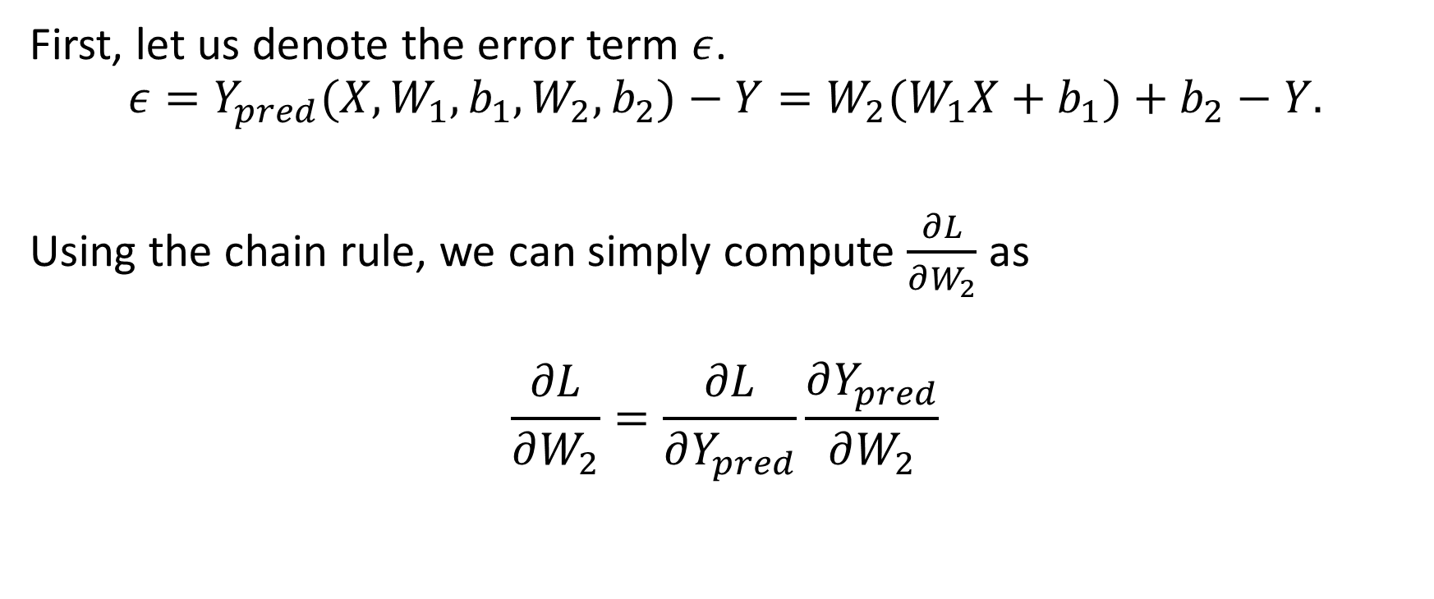
Chain rule, to the rescue!
First, let us denote the error term $ε$.
$$ε=Y_{pred}(X,W_{1},b_{1},W_{2},b_{2})−Y=W_{2}(W_{1}X+b_{1})+b_{2}−Y.$$
Using the chain rule, we can simply compute $\frac{∂L}{∂W_{2}}$ as
$$\frac{∂L}{∂W_{2}}=\frac{∂L}{∂Y_{pred}}\frac{∂Y_{pred}}{∂W_{2}}$$

Slide 10
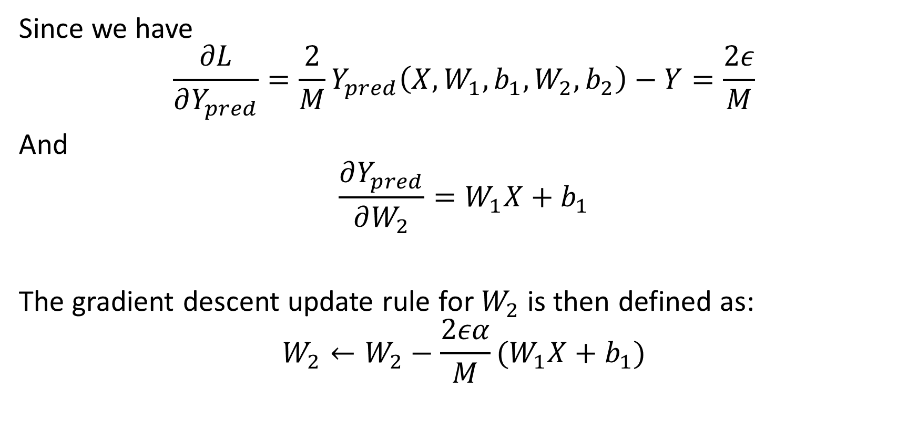
Chain rule, to the rescue!
Since we have
$$\frac{∂L}{∂Y_{pred}}=\frac{2}{M}Y_{pred}\left(X,W_{1},b_{1},W_{2},b_{2}\right)−Y=\frac{2ε}{M}$$
And
$$\frac{∂Y_{pred}}{∂W_{2}}=W_{1}X+b_{1}$$
The gradient descent update rule for $W_{2}$ is then defined as:
$$W_{2}←W_{2}−\frac{2εα}{M}(W_{1}X+b_{1})$$

Slide 11
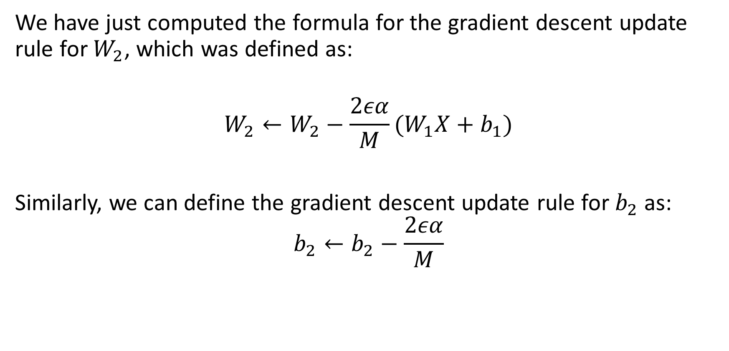
Chain rule, to the rescue!
We have just computed the formula for the gradient descent update rule for $W_{2}$, which was defined as:
$$W_{2}←W_{2}−\frac{2εα}{M}(W_{1}X+b_{1})$$
Similarly, we can define the gradient descent update rule for $b_{2}$ as:
$$b_{2}←b_{2}−\frac{2εα}{M}$$

Slide 12
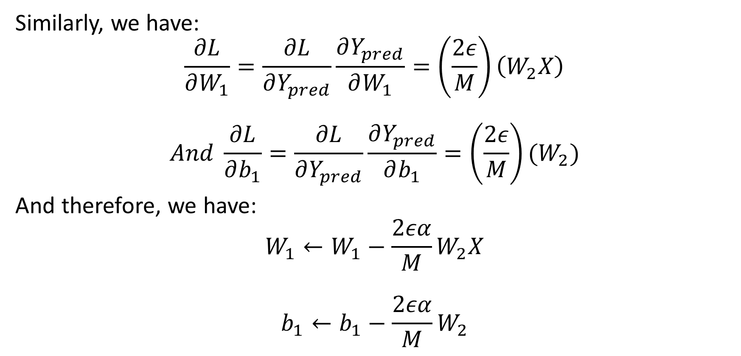
Chain rule, to the rescue!
Similarly, we have:
$$\frac{∂L}{∂W_{1}}=\frac{∂L}{∂Y_{pred}}\frac{∂Y_{pred}}{∂W_{1}}=\left(\frac{2ε}{M}\right)\left(W_{2}X\right)$$
$$And \frac{∂L}{∂b_{1}}=\frac{∂L}{∂Y_{pred}}\frac{∂Y_{pred}}{∂b_{1}}=\left(\frac{2ε}{M}\right)(W_{2})$$
And therefore, we have:
$$W_{1}←W_{1}−\frac{2εα}{M}W_{2}X$$
$$b_{1}←b_{1}−\frac{2εα}{M}W_{2}$$

Slide 13
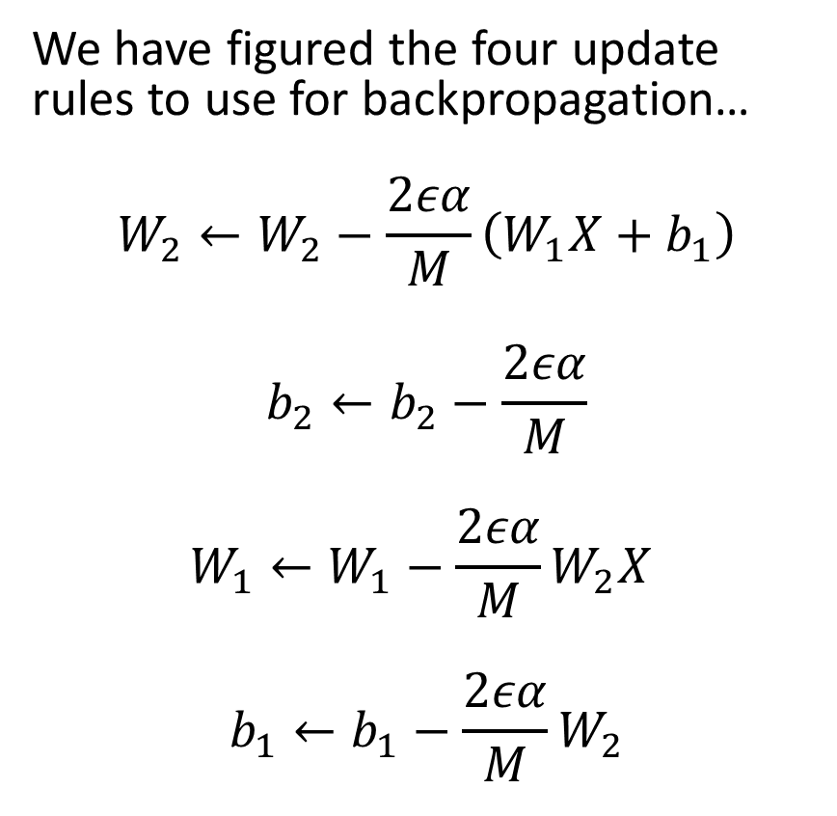
Now that we have all update rules…
We have figured the four update rules to use for backpropagation…
$$W_{2}←W_{2}−\frac{2εα}{M}\left(W_{1}X+b_{1}\right)$$
$$b_{2}←b_{2}−\frac{2εα}{M}$$
$$W_{1}←W_{1}−\frac{2εα}{M}W_{2}X$$
$$b_{1}←b_{1}−\frac{2εα}{M}W_{2}$$
Now it is about implementing two additional methods for our Neural Network class:
Backward method: It performs the calculation of gradients, in matrix form, and parameters adjustments using the gradient descent update rules shown on the left.
Trainer method: It repeats the backward method, reusing the gradient descent for-loop function from earlier in Notebook 2, until a maximal number of iterations is reached or convergence is seen.

Slide 14
Training procedure, in short.
Forward pass on dataset samples. Compute errors and loss function.
Use new loss value to compute gradients. Adjust parameters with backprop.
Repeat until convergence or max number of iterations, as in GD earlier.

Slide 15
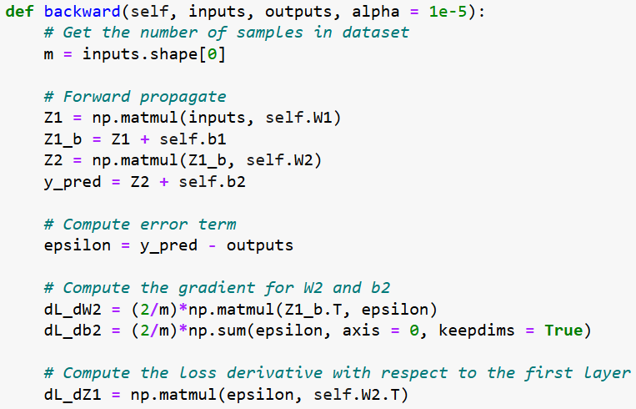
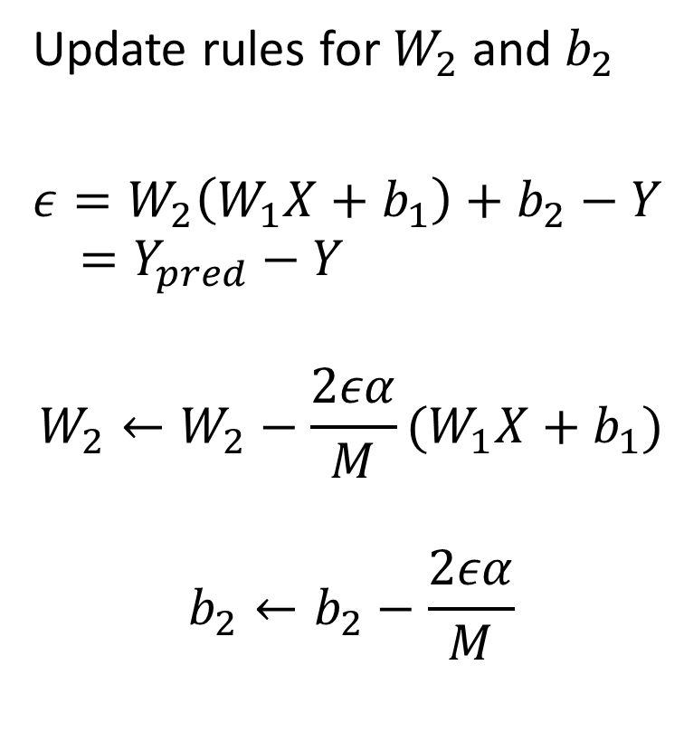
Backpropagation in our model
Update rules for $W_{2}$and $b_{2}$
$ε=W_{2}\left(W_{1}X+b_{1}\right)+b_{2}−Y$ $=Y_{pred}−Y$
$$W_{2}←W_{2}−\frac{2εα}{M}(W_{1}X+b_{1})$$
$$b_{2}←b_{2}−\frac{2εα}{M}$$

Slide 16
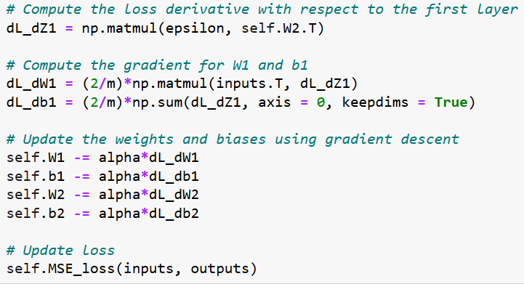
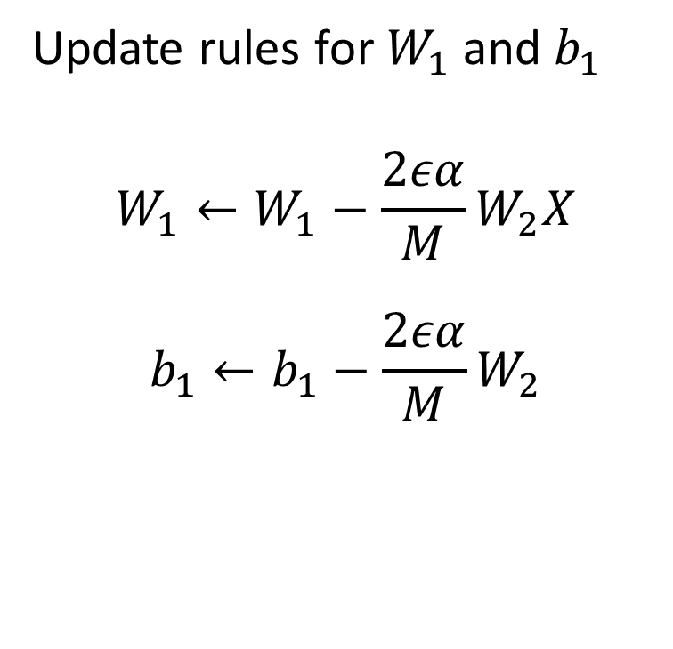
Backpropagation in our model
Update rules for $W_{1}$and $b_{1}$
$$W_{1}←W_{1}−\frac{2εα}{M}W_{2}X$$
$$b_{1}←b_{1}−\frac{2εα}{M}W_{2}$$

Slide 17
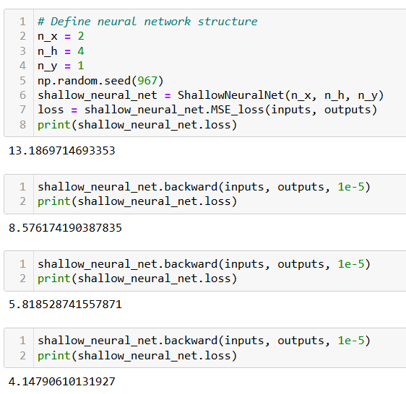
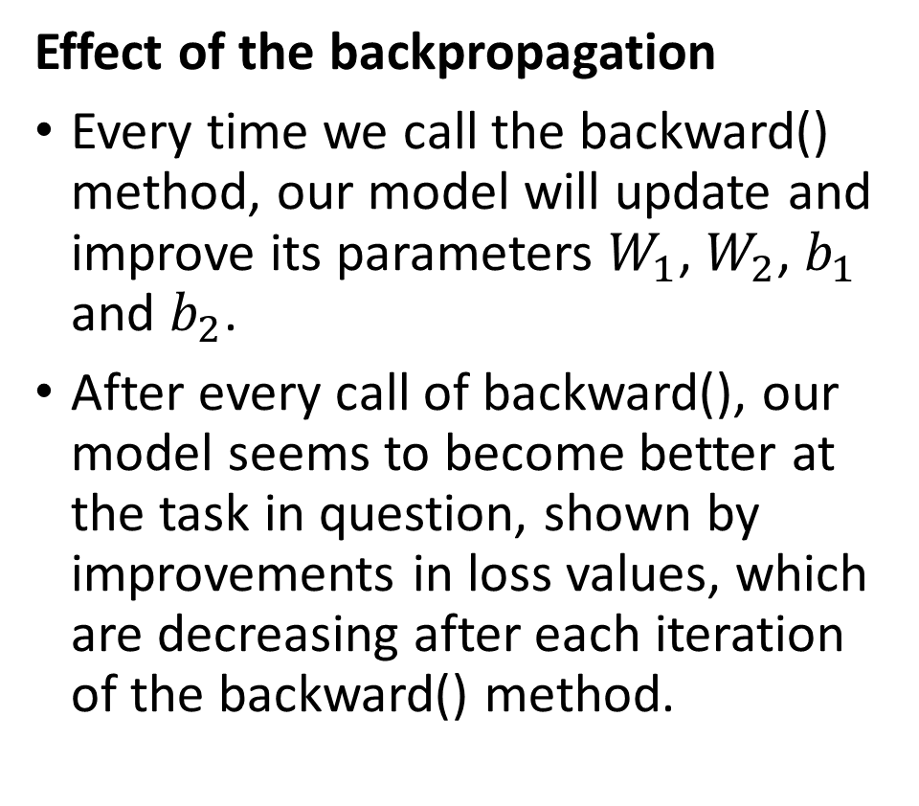
Backpropagation in our model
Effect of the backpropagation
Every time we call the backward() method, our model will update and improve its parameters $W_{1}$, $W_{2}$, $b_{1}$ and $b_{2}$.
After every call of backward(), our model seems to become better at the task in question, shown by improvements in loss values, which are decreasing after each iteration of the backward() method.

Slide 18
Training procedure, in short (reminder).
Forward pass on dataset samples. Compute errors and loss function.
Use new loss value to compute gradients. Adjust parameters with backprop.
Repeat until convergence or max number of iterations, as in GD earlier.
→ Done.
→ Done.
Next!

Slide 19
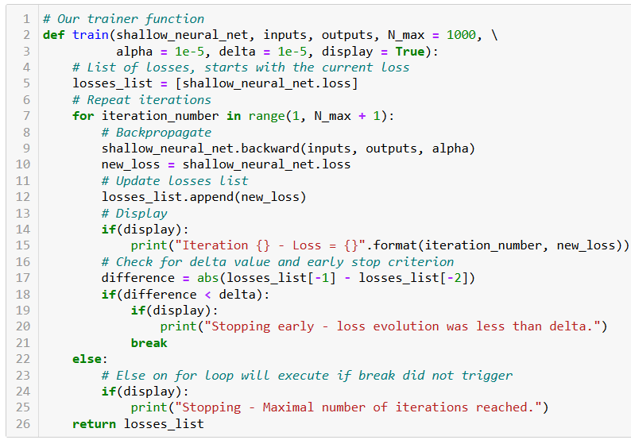
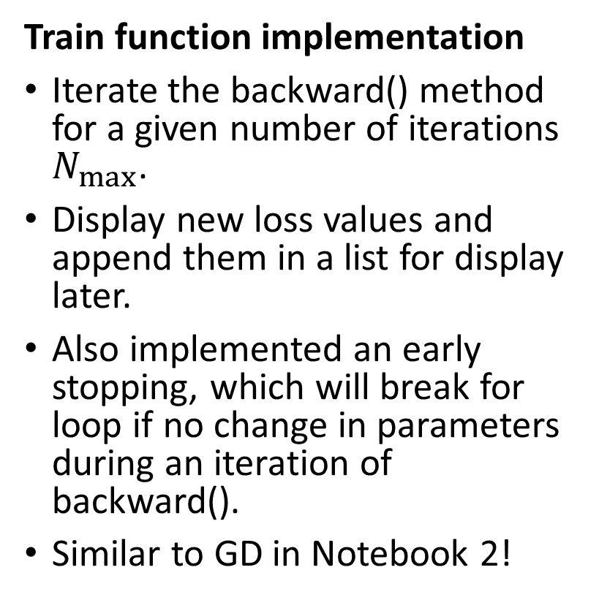
Trainer function for our model
Train function implementation
Iterate the backward() method for a given number of iterations $N_{max}$.
Display new loss values and append them in a list for display later.
Also implemented an early stopping, which will break for loop if no change in parameters during an iteration of backward().
Similar to GD in Notebook 2!

Slide 20
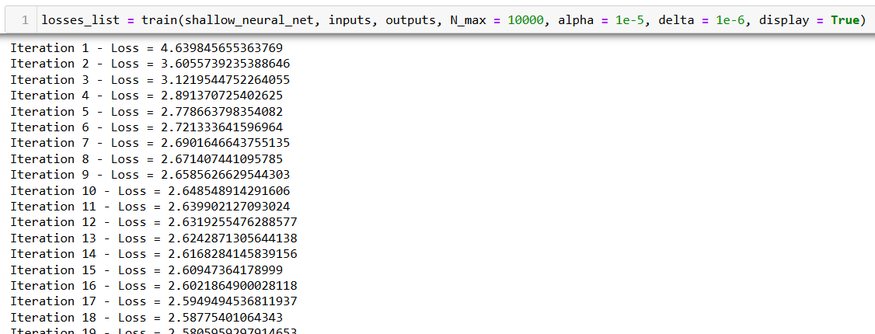
Trainer function for our model
Successful training as losses are decreasing over iterations?

Slide 21
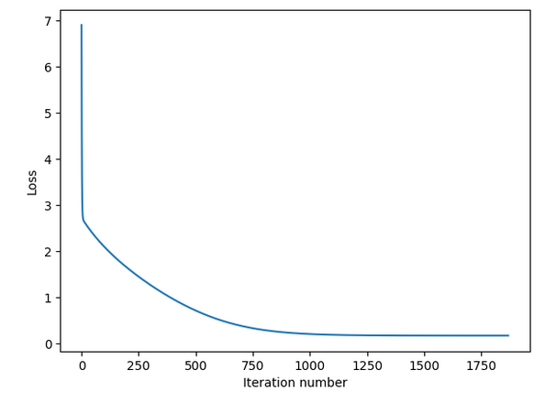
Trainer function for our model
The curves below are called training curves and are useful to show how the training went (make an extra viz method to be used after training?).
Loss has decreased and converged.
Confirmed training?

Slide 22
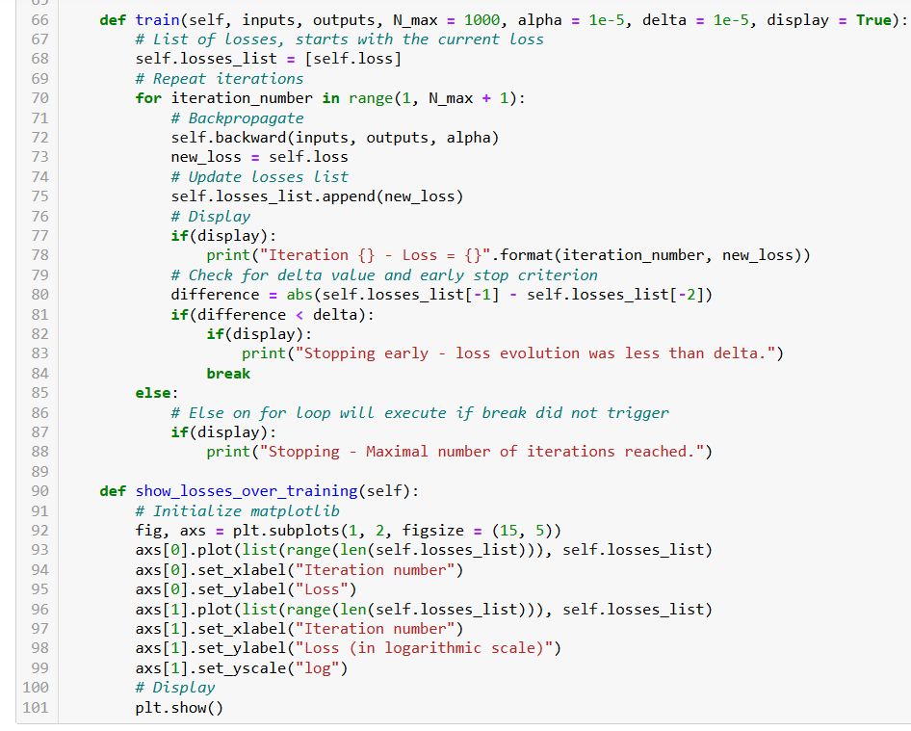
Finally, we will make the trainer function and the performance curves function into methods for our class.

Slide 23
Backpropagation is heavy to manually calculate and implement… Strongly encouraging to try and redo the math/implementation shown on your own!
That’s the best way to learn and you can always refer to these slides for answers!
After math is correct, have a look at how to implement it in a backward method (also shown in slides, but probably will be shown rapidly in class!)
Remember, you have no homework this week, so let us call that your homework!

Slide 24
Conclusion (Day 1)
Reminders of Machine Learning
Linear
Using a normal equation to train a linear regression
Gradient descent as a training procedure for linear regression
Polynomial Regression
Regularization in Ridge/Lasso Regression
Train-test split
Overfitting and underfitting
Generalization
Sigmoid and Logistic functions
From linear regression to logistic regression
Using logistic regression for binary classification

Slide 25
Conclusion (Day 1)
Implementing a shallow neural network in Numpy
Forward propagation method, to formulate predictions
The backpropagation mechanism, as the gradient descent on Neural Network
Backward method for training and trainer functions to iterate backward iterations
Performance/training curves
Next week?
Initializations to break symmetries
Exploding and vanishing gradients
Activation functions and non-linearities in Neural Networks
Advanced optimizers
Validation sets, early stopping, saver and loader functions

Slide 26
Learn more about these topics
Out of class, supporting papers, for those of you who are curious.
[Géron2019] A. Géron , “How Neural Networks Work”, 2019.
[Yamins2016] Yamins et al., “Deep neural networks are robust computational models of the human visual system”, 2016.
[Kriegeskorte2013] Kriegeskorte and Kievit, “Neural Network Models of the Human Brain”, 2013.
[Rumelhart1986] D.E. Rumelhart, G. Hinton, Williams, “Learning representations by back-propagating errors“, 1986. https://www.nature.com/articles/323533a0

Slide 27
Learn more about these topics
Keep track of important names and follow their social media (Follow them on Scholar, Twitter, or whatever works for you!)
Geoffrey Hinton: Emeritus Professor at University of Toronto, one of the three Godfathers of Deep Learning and 2018 Turing Award winner (highest distinction in Computer Science), Nobel Prize Physics 2025. Formerly, Google. https://www.cs.toronto.edu/~hinton/ https://scholar.google.co.uk/citations?user=JicYPdAAAAAJ&hl=en
David Rumelhart: Former professor at University of California, credited for inventing backpropagation along with Hinton. Passed away in 2011. https://www.nytimes.com/2011/03/19/health/19rumelhart.html

Slide 28
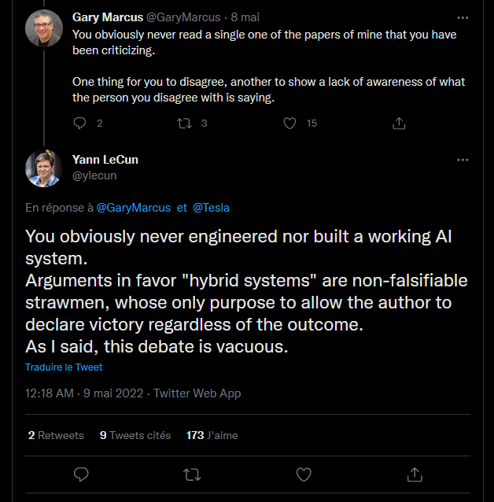
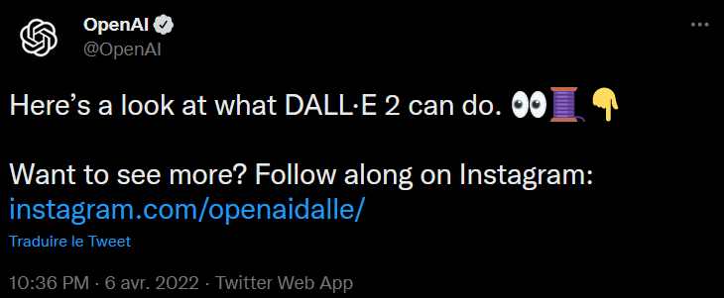
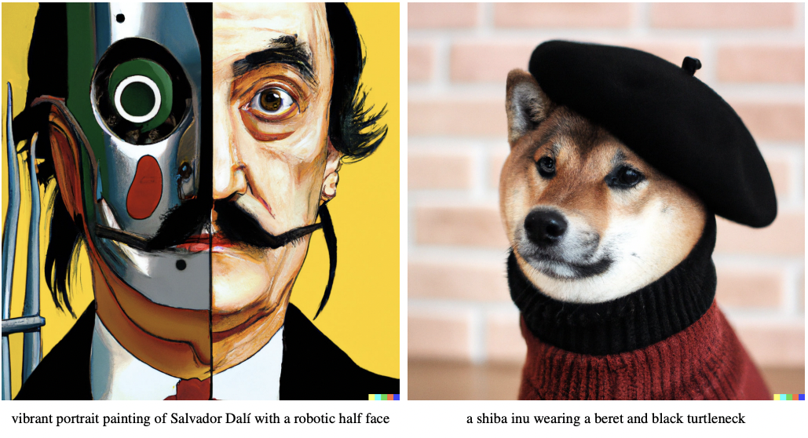
Twitter, the theater for AI/DL drama and announcements
NYU Professor
Announcing Dall-E 2 and its future release
NYU Professor and Chief of AI at Meta (Facebook)

Slide 29
Learn more about these topics
Some extra (easy) reading and videos for those of you who are curious.
[Quanta2021] “Artificial Neural Nets Finally Yield Clues to How Brains Learn“, 2021. https://www.quantamagazine.org/artificial-neural-nets-finally-yield-clues-to-how-brains-learn-20210218/
[MITNews2022] “Study urges caution when comparing neural networks to the brain”, 2022. https://news.mit.edu/2022/neural-networks-brain-function-1102
[Medium2020] “Who Invented Backpropagation? Hinton Says He Didn’t, but His Work Made It Popular“, 2020. https://medium.com/syncedreview/who-invented-backpropagation-hinton-says-he-didnt-but-his-work-made-it-popular-e0854504d6d1/

Slide 30
Day 1 Knowledge Check Quiz
As part of your assessment, please take the time to answer the following knowledge check/quiz below.
Deadline: XXXX

